Slide 1

Discovery of Therapeutic Biomarkers and their Potential Inhibitors for Liver Cancer Therapy Using Bioinformatics Approaches
Team Members:
Balqees Mansour | Salaam Ridwan | Rukaya Omotosho-Sanni | Ajisegiri Sewedo Blessing

Slide 2
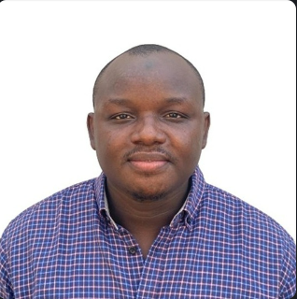
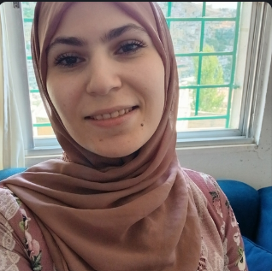
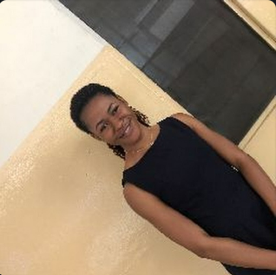

Team Members and their Roles
Salaam Ridwan
Project conceptualization
Compound retrieval & Molecular docking result interpretation
Balqees Mansour
DEA Analysis and Visualization
Functional enrichment analysis
Ajisegiri Blessing Sewedo
Functional enrichment result interpretation
Manuscript writing (Abstract & materials and methods)
Rukayat Omotosho-Sanni
DEA Analysis and Interpretation
Manuscript writing (result & Discussion)
Manuscript writing (Introduction & Discussion)
Dataset retrieval and preprocessing
Protein preparation and molecular docking
ADMET analysis & interpretation
Manuscript writing (result & Discussion)

Slide 3
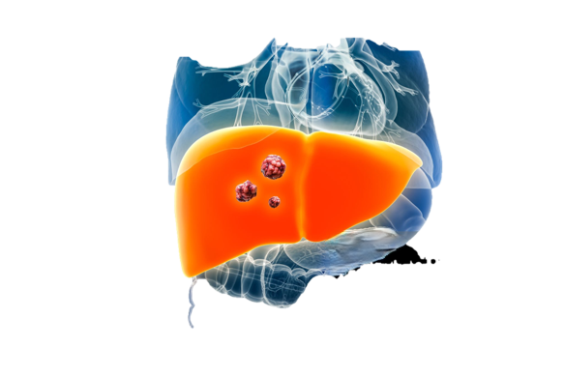
Introduction
Biomarker discovery
Small molecule discovery
Third leading cause of mortality globally
Suboptimal performance by conventional biomarkers
Need for more effective biomarkers (Rashid et al., 2023; Mansouri et al., 2020)
Chemotherapy – common therapeutic approach for cancer
Sorafenib & HCC
Limitations – below average survival time, adverse side-effects, drug resistance (Anwanwan et al., 2020)

Slide 4
Method flowcharts
DEA and FEA
Identification of potential therapeutic biomarkers
Molecular docking & ADMET profiling
TPG-inhibitors
Identification of promising anti-liver cancer small molecules
Manuscript writing and submission

Slide 5
Expected results
DEA & FEA
Identified upregulated and downregulated genes
Identified significantly enriched biological processes, molecular functions, cellular compartments and KEGG pathways
Molecular docking and ADMET Profiling
Identified promising Protein-ligand complexes
Profiled pharmacokinetic and pharmacodynamics properties of promising drugs
Manuscript writing
A well-written and complete manuscript for submission to Team Hackbio
Submission of reviewed, plagiarism-free manuscript to a reputable journal

Slide 6
Q/A Session

